Slide 1
Unsupervised learning

Slide 2
Types of machine learning
Unsupervised Learning in R
Unsupervised learning
Finding structure in unlabelled data
Supervised learning
Making predictions based on labeled data
Predictions like regression or classification

Slide 3

Unsupervised learning
Unsupervised Learning in R
●
Finding homogenous subgroups within larger group
People have features such as income, education atainment, and gender

Slide 4

Unsupervised learning
Unsupervised Learning in R
●
Finding homogenous subgroups within larger group

Slide 5
Unsupervised learning
Unsupervised Learning in R
●
Finding homogenous subgroups within larger group
Subgroup A
Subgroup B

Slide 6
Unsupervised learning
Unsupervised Learning in R
●
Finding homogenous subgroups within larger group
●
Clustering
Subgroup A
Subgroup B

Slide 7


Clustering examples
Unsupervised Learning in R

Slide 8
Unsupervised learning
Unsupervised Learning in R
●
Finding homogenous subgroups within larger group
●
Clustering
●
Finding patterns in the features of the data
●
Dimensionality reduction

Slide 9
Dimensionality reduction
Unsupervised Learning in R
Find patterns in the features of the data Visualization of high dimensional data
Pre-processing before supervised learning

Slide 10
Challenges and benefits
Unsupervised Learning in R
No single goal of analysis
Requires more creativity
Much more unlabeled data available than cleanly labeled data
●
●
●

Slide 11
Introduction to
k-means clustering

Slide 12
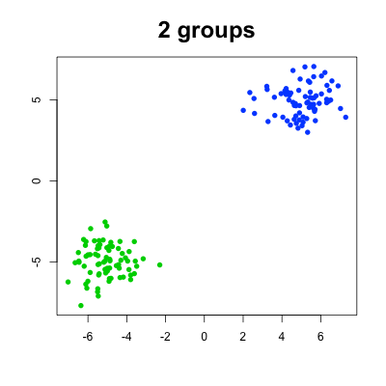
k-means clustering algorithm
Unsupervised Learning in R
First of two clustering algorithms covered in this course Breaks observations into pre-defined number of clusters
●
●
Subgroup 1
Subgroup 2

Slide 13

k-means in R
Unsupervised Learning in R
> # k-means algorithm
> kmeans , =
with 5 centers, run 20 times
5, = 20)
(x
centers
nstart
One observation per row, one feature per column k-means has a random component
Run algorithm multiple times to improve odds of the best model
●
●
●

Slide 14
First exercises
Unsupervised Learning in R
●
First exercise uses synthetic data
Synthetic data generated from 3 subgroups Selecting the best number of subgroups for k-means Example with more fun data later in the chapter
●
●
●

Slide 15
How kmeans() works and practical maters

Slide 16
Objectives
Unsupervised Learning in R
Explain how k-means algorithm is implemented visually Model selection: determining number of clusters
●
●

Slide 17

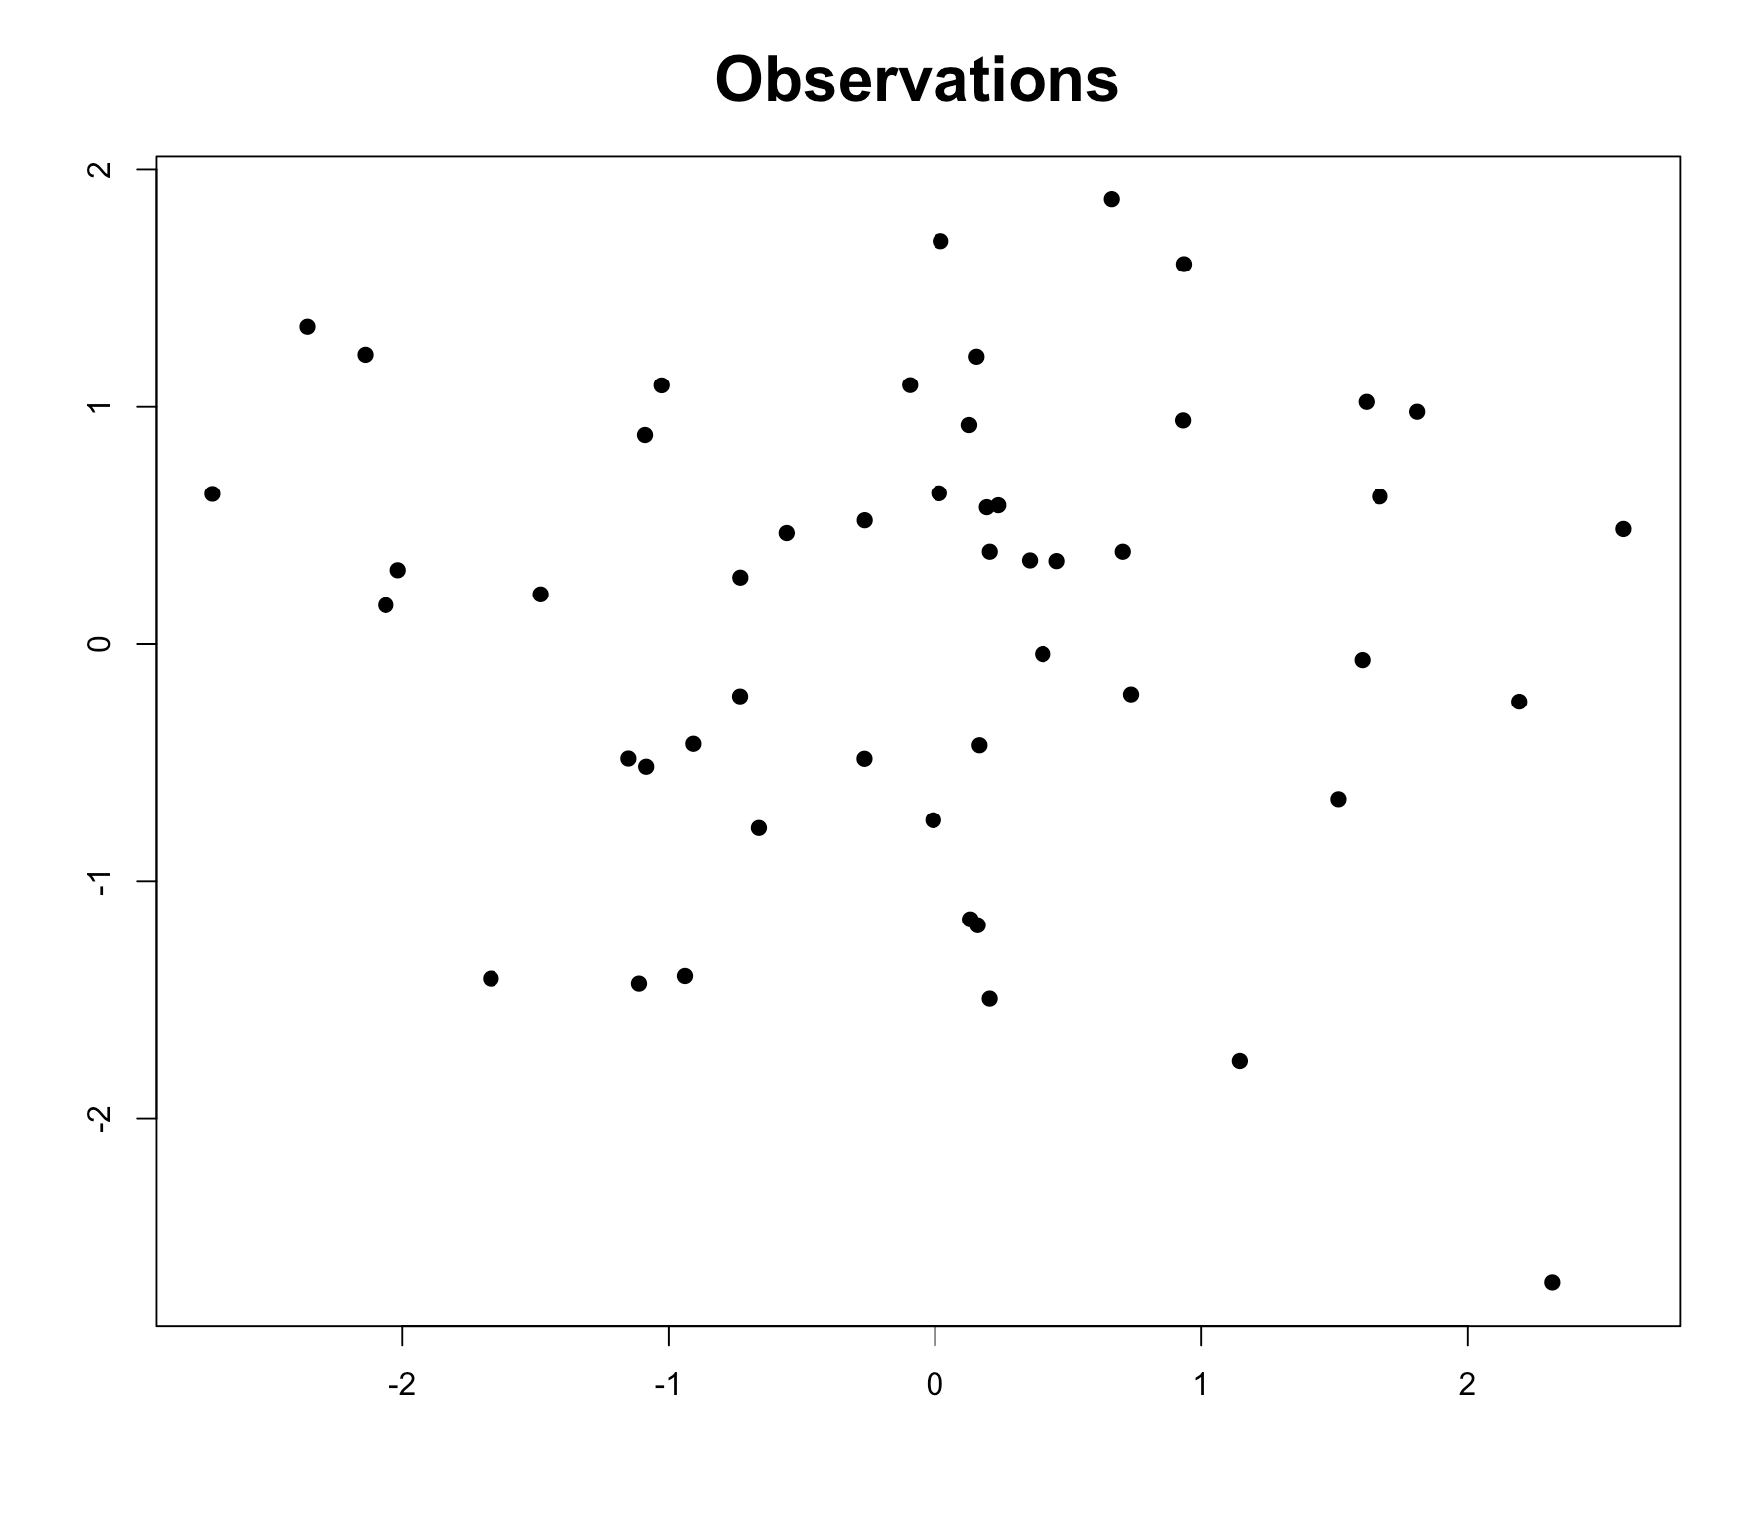
Unsupervised Learning in R

Slide 18
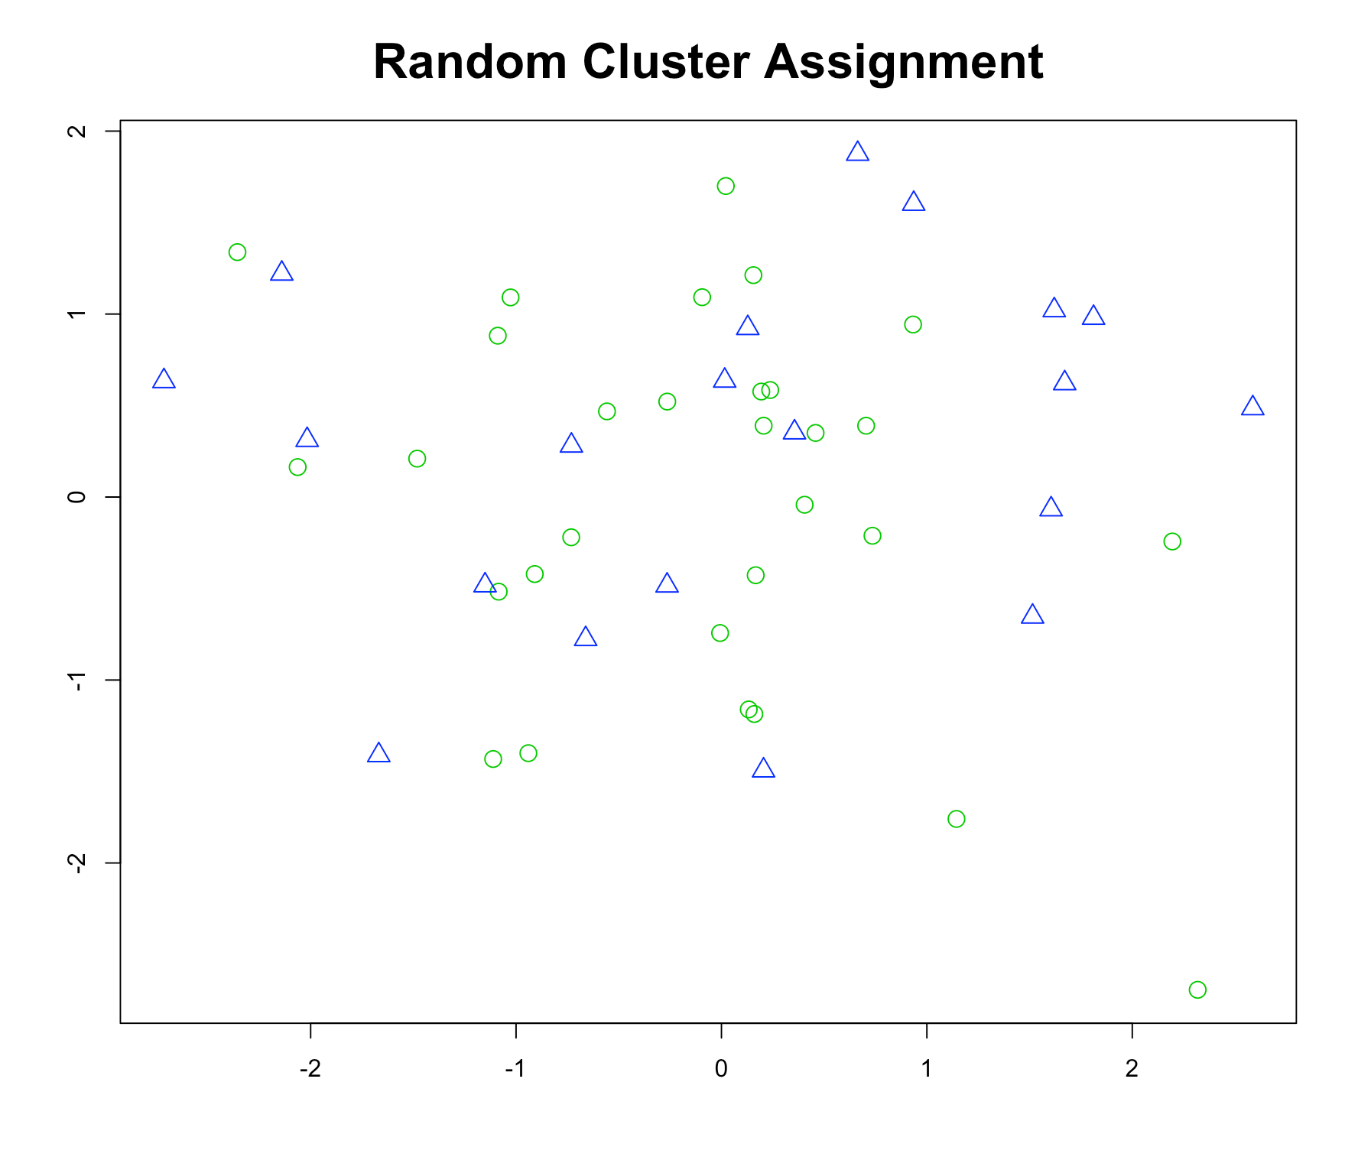
Unsupervised Learning in R

Slide 19
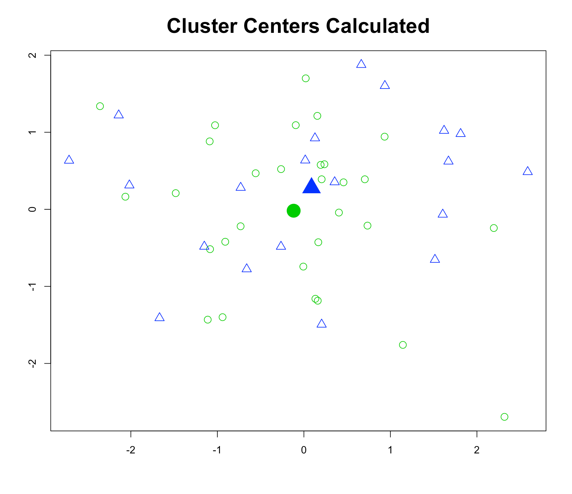
Unsupervised Learning in R

Slide 20
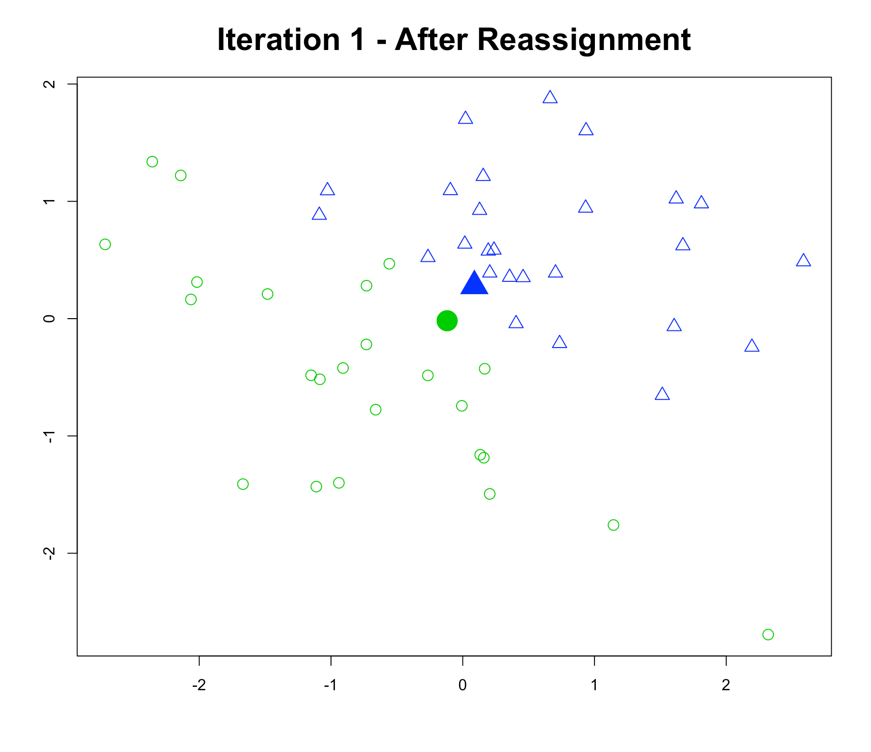
Unsupervised Learning in R

Slide 21
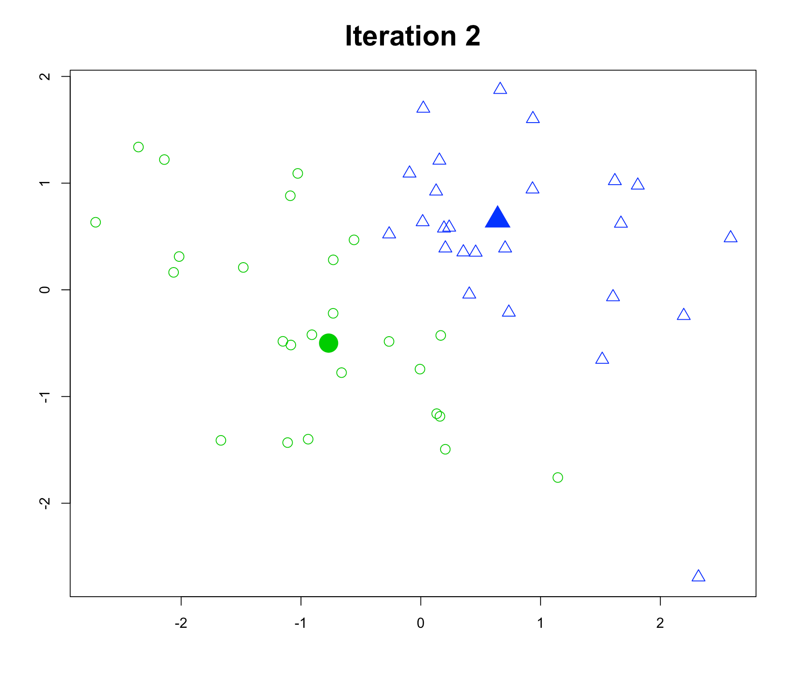
Unsupervised Learning in R

Slide 22
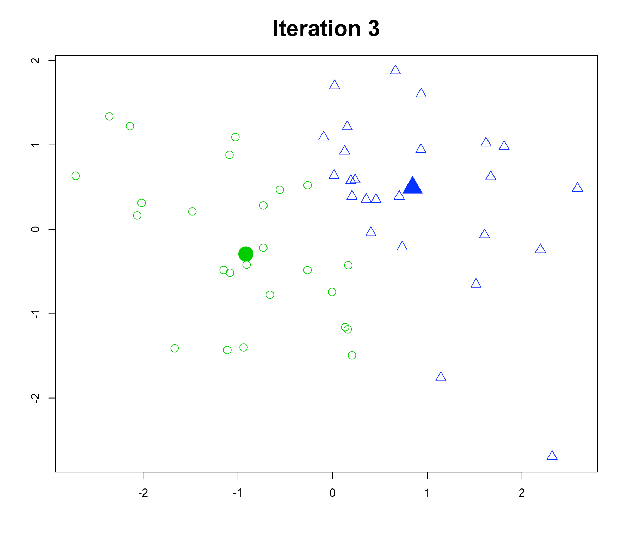
Unsupervised Learning in R

Slide 23
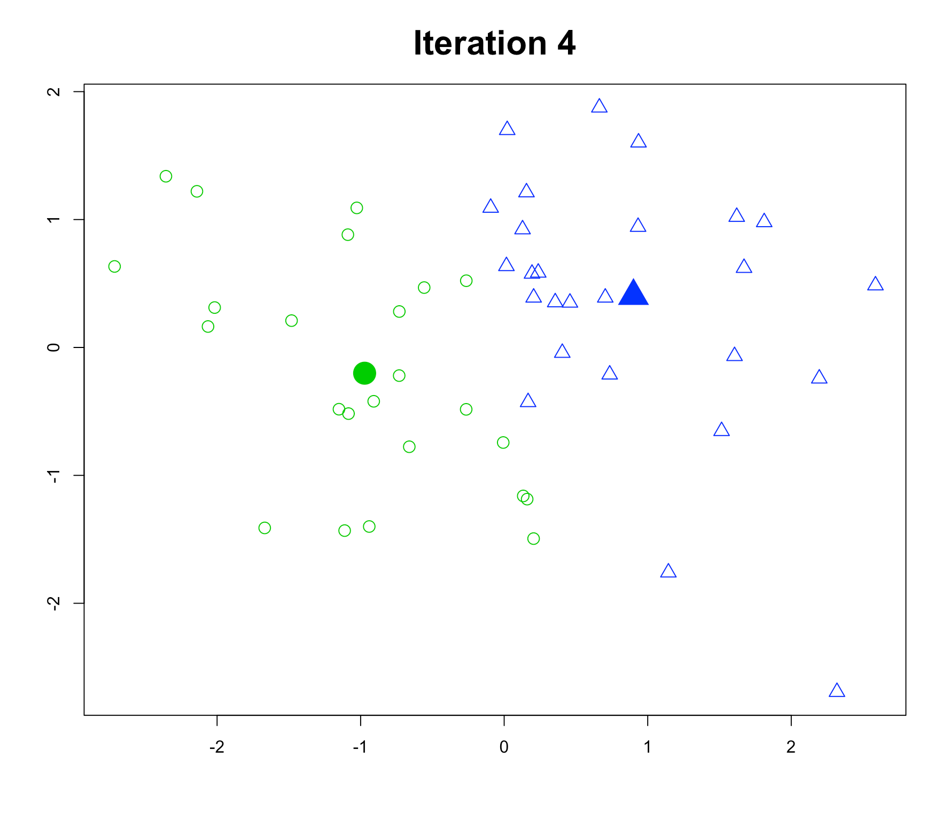
Unsupervised Learning in R

Slide 24
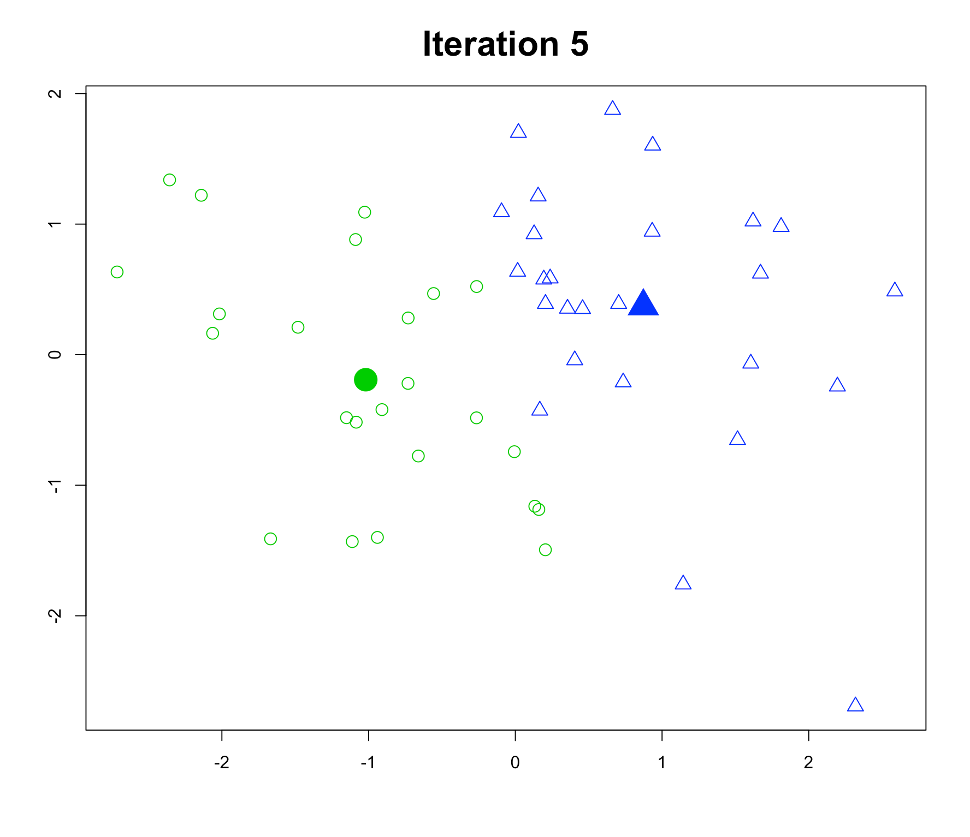
Unsupervised Learning in R

Slide 25
Model selection
Unsupervised Learning in R
●
Recall k-means has a random component
Best outcome is based on total within cluster sum of squares:
●
●
For each cluster
●
For each observation in the cluster
Determine squared distance from observation to cluster center
Sum all of them together
●
●

Slide 26

Model selection
Unsupervised Learning in R
> # k-means algorithm
> kmeans(x, centers =
with 5 centers,
5, )
run 20 times
nstart = 20
●
Running algorithm multiple times helps find the global minimum total within cluster sum of squares
You’ll see an example in the exercises
●

Slide 27
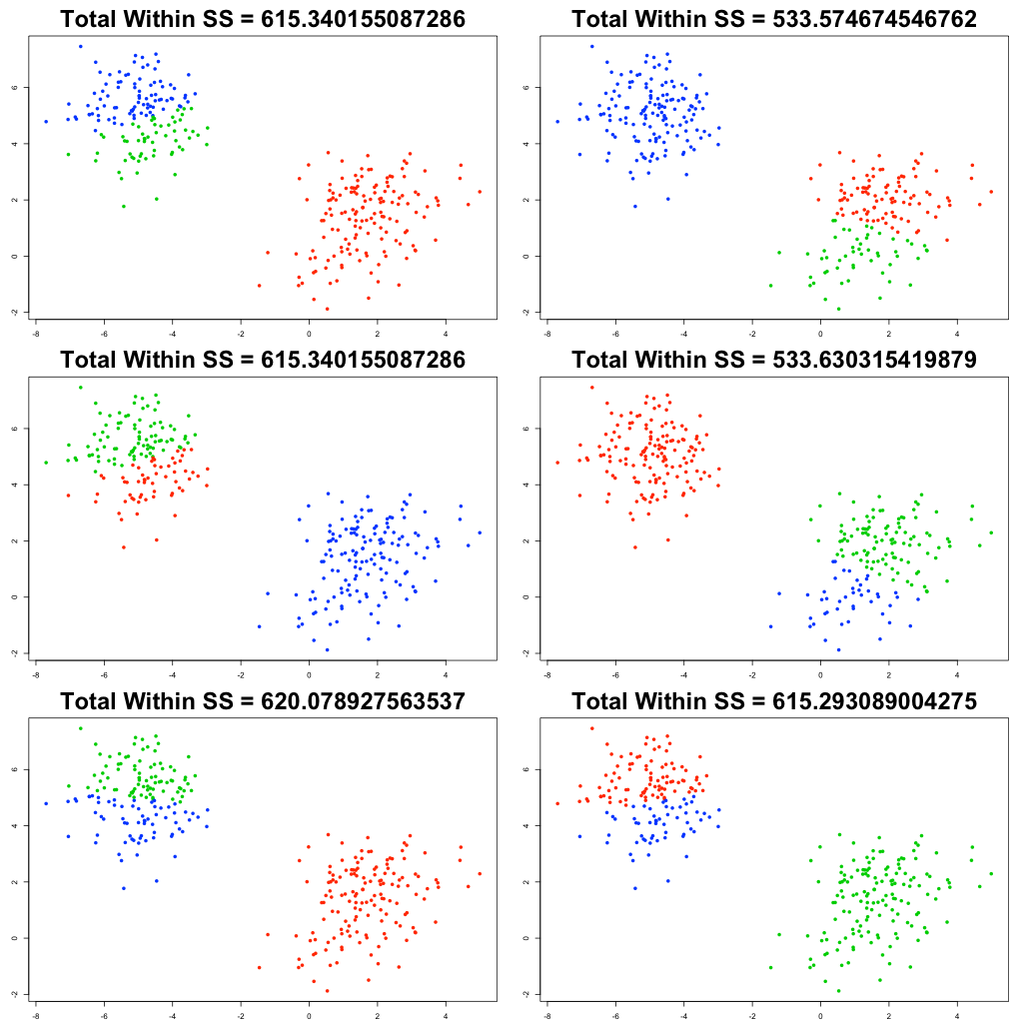
Unsupervised Learning in R
Identical groupings and Total Within SS, but diﬀerent cluster labels

Slide 28
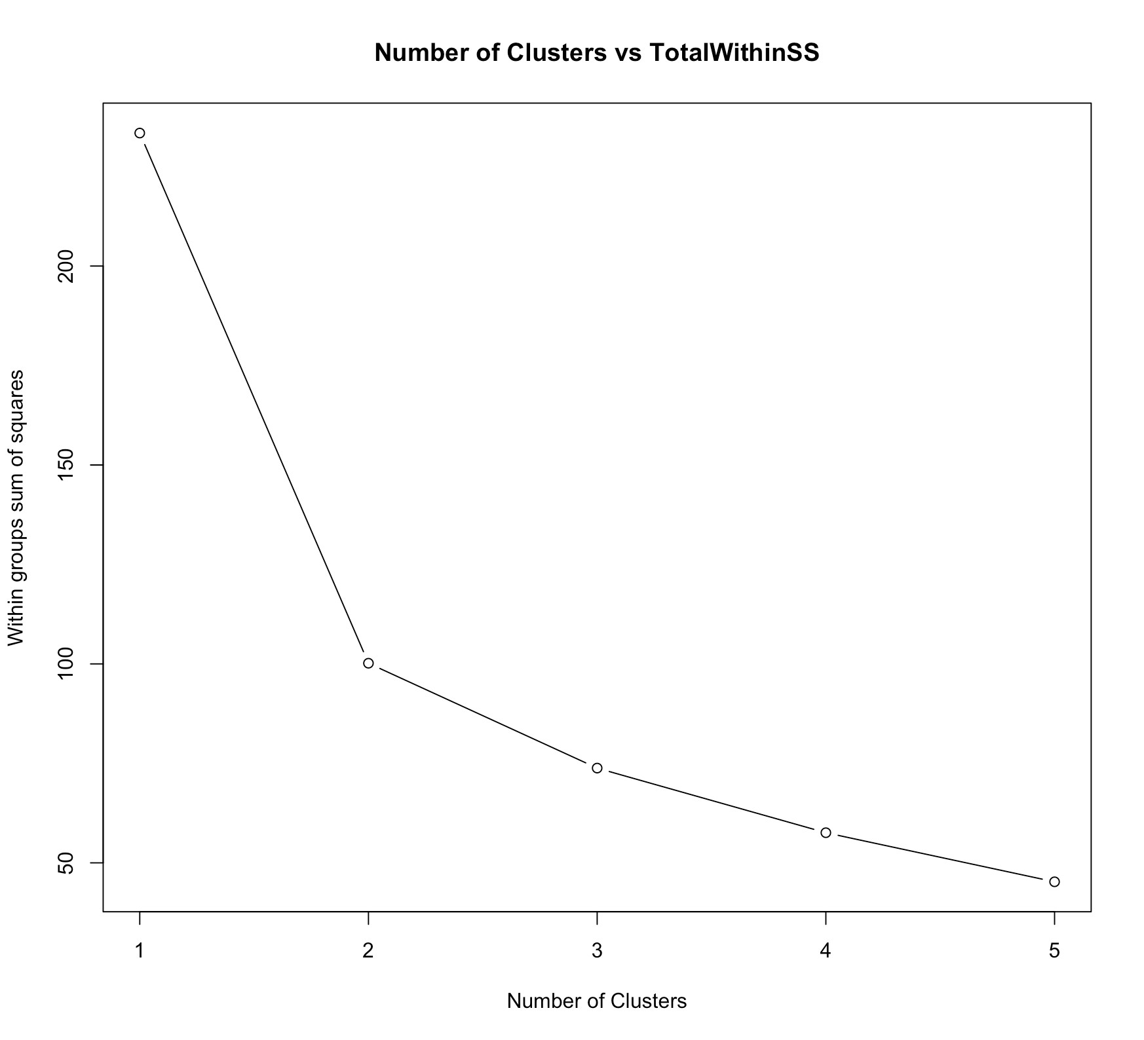
Determining number of clusters
Unsupervised Learning in R
●
Trial and error is not the best approach
Scree plot
Elbow at 2
Total Within SS
Number of clusters

Slide 29
Introduction to Pokemon data

Slide 30

"Real" data exercise
Unsupervised Learning in R

Slide 31

The Pokemon dataset
Unsupervised Learning in R
> head(pokemon)
[1,] | 45 |  | 49 |  | 49 |  | 65 |  | 65 |  | 45
[2,] | 60 |  | 62 |  | 63 |  | 80 |  | 80 |  | 60
[3,] | 80 |  | 82 |  | 83 |  | 100 |  | 100 |  | 80
[4,] | 80 |  | 100 |  | 123 |  | 122 |  | 120 |  | 80
[5,] | 39 |  | 52 |  | 43 |  | 60 |  | 50 |  | 65
[6,] | 58 |  | 64 |  | 58 |  | 80 |  | 65 |  | 80
HitPoints
Attack
Defense
SpecialAttack
SpecialDefense
Speed
●
Hosted at h5ps://www.kaggle.com/abcsds/pokemon
More information on Pokemon and these features can be found at h5p://pokemondb.net/pokedex
●

Slide 32
Data challenges
Unsupervised Learning in R
●
Selecting the variables to cluster upon Scaling the data (will handle in last chapter) Determining the number of clusters
●
●
Oken no clean "elbow" in scree plot This will be a core part of the exercises
●
●
●
Visualize the results for interpretation

